Slide 1


SMS Project
Final Report

Slide 2

Contents
1
Introduction
2
Hardware & Software
3
Mechanism
4
Experiments and results
5
Conclusion

Slide 3
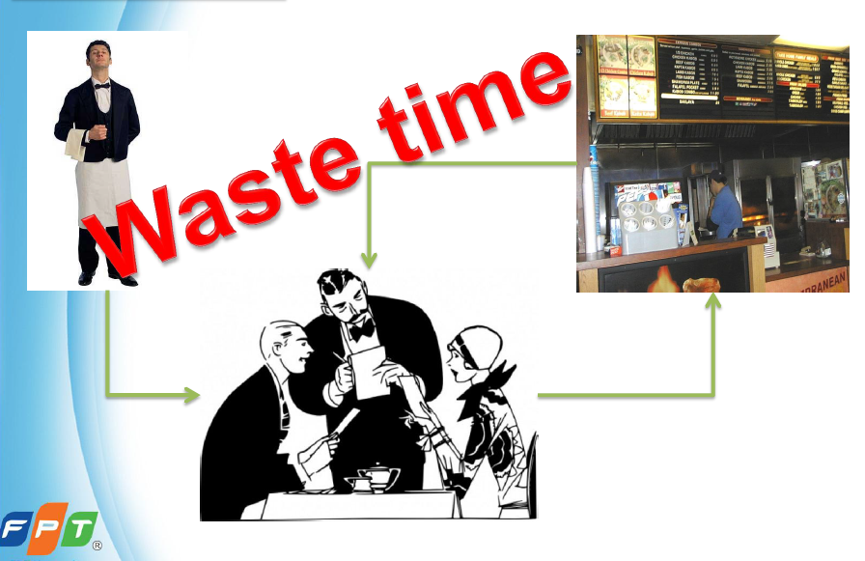
Traditional process
Introduction

Slide 4

Problem
Introduction

Slide 5
Problem
Introduction
Redundant
Errors
Time consuming
Money wasting

Slide 6
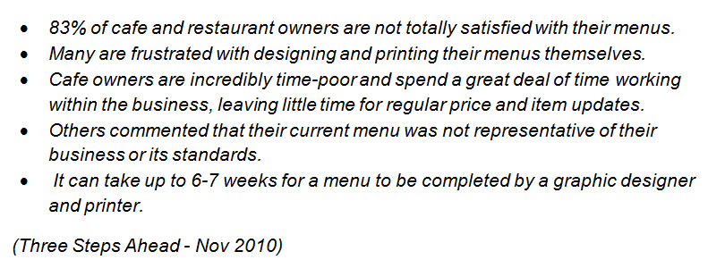
Problem
Introduction

Slide 7
Attempts in improvement
Introduction
World
Plate
Usablehealth
VietNam
BicProductioniMenu
VienPhuc ezMenu

Slide 8
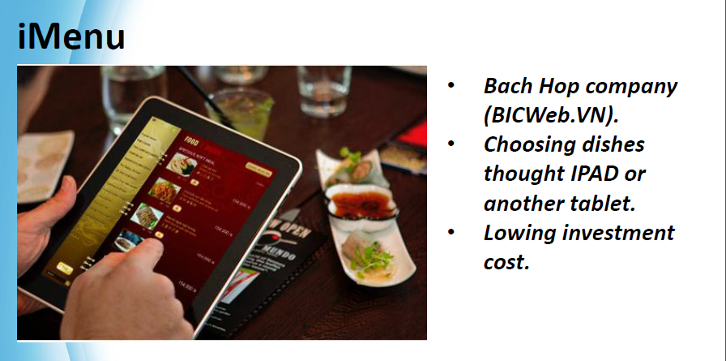
Attempts in improvement
Introduction

Slide 9
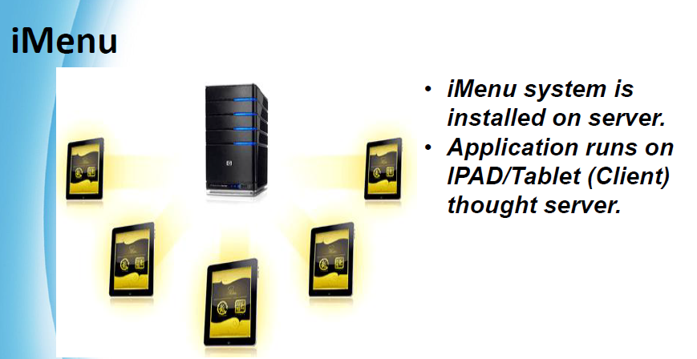
Attempts in improvement
Introduction

Slide 10
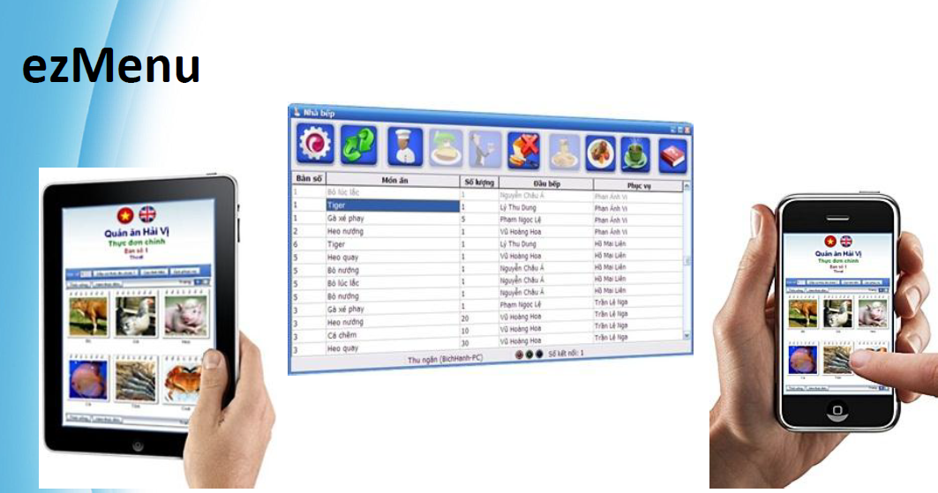
Attempts in improvement
Introduction

Slide 11
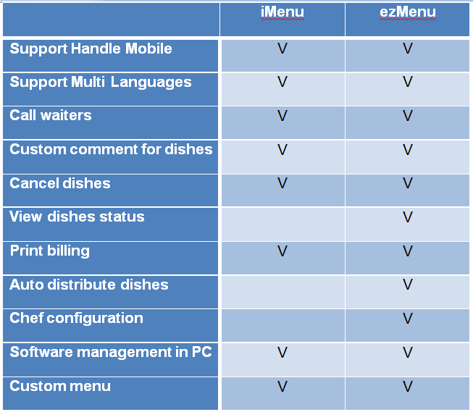
Attempts in improvement
Introduction

Slide 12
SMS
Introduction
Smart Menu Solution (SMS)
Carry out automatically many step in the old serving process.
Save time
Prevent errors
Reduce costs
Improve service quality

Slide 13
Function
Introduction
Ordering: Provide a new electric system replace the tradition way in ordering dishes.
Management: Provide a window management software to manage orders, billing, statistic and automatically distribute dishes to chef.

Slide 14
Feature
Introduction
Using SMO to select menu.
Support two languages: English or Vietnam
View dishes' status: not done, doing or done.
May cancel dishes if it haven’t been done yet.
Call waiter for additional or unusual request.
Automatic distribute orders to kitchen.
Quick billing.
Develop using “Yakindu” for easy maintain and update.

Slide 15
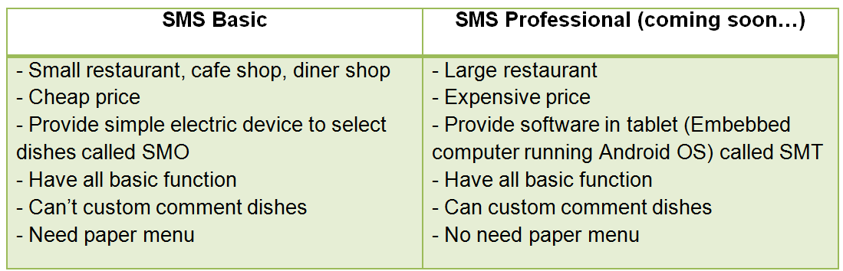
Scope
Introduction

Slide 16
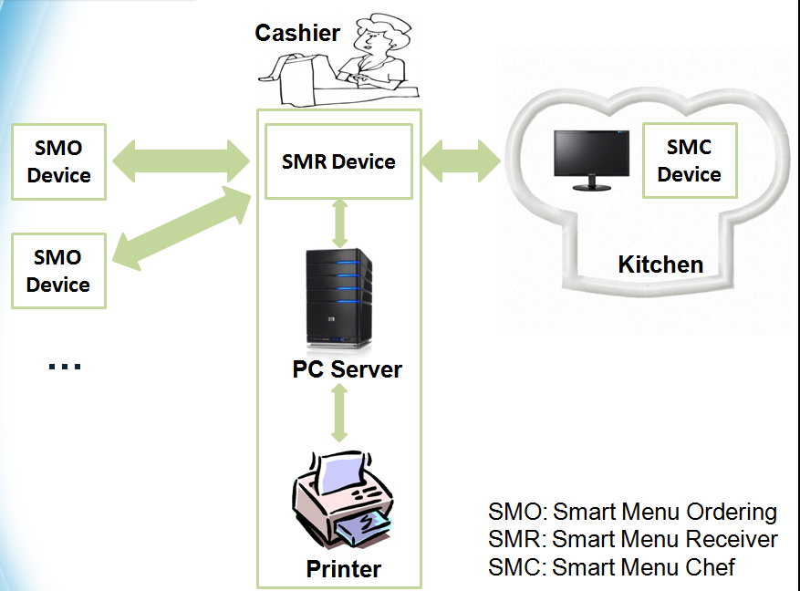
Global picture
Introduction

Slide 17
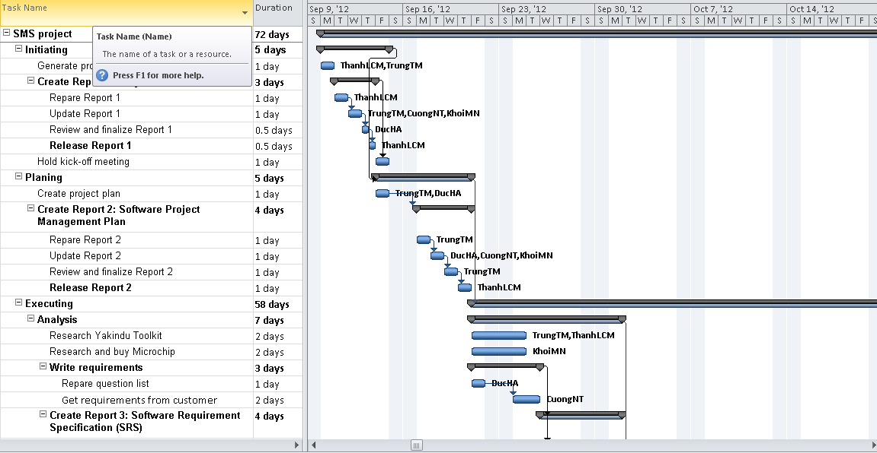
Project Plan
Introduction

Slide 18
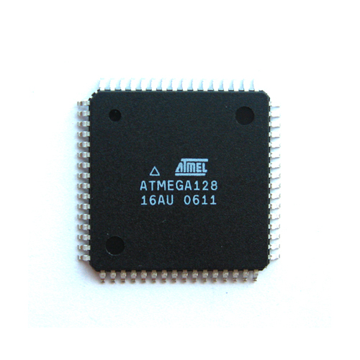
Hardware
Hard & Soft
High-performance, Low-power AVR® 8-bit Microcontroller
High Endurance Non-volatile Memory segments
JTAG (IEEE std. 1149.1 Compliant) Interface
Peripheral Features
Special Microcontroller Features
I/O and Packages
Operating Voltages: 4.5 - 5.5V
Speed Grades: 0 - 16 MHz
ATmega128-16AU

Slide 19
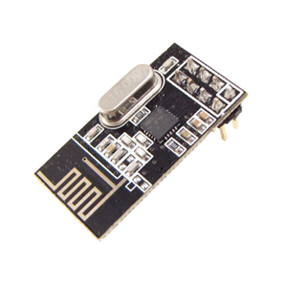
Hardware
Hard & Soft
Low cost single-chip 2.4GHz GFSK RF transceiver IC
Worldwide license-free 2.4GHz ISM band operation
1Mbps and 2Mbps on-air data-rate
Enhanced ShockBurst™ hardware protocol accelerator
Ultra low power consumption – months to years of battery lifetime
nRF24L01

Slide 20
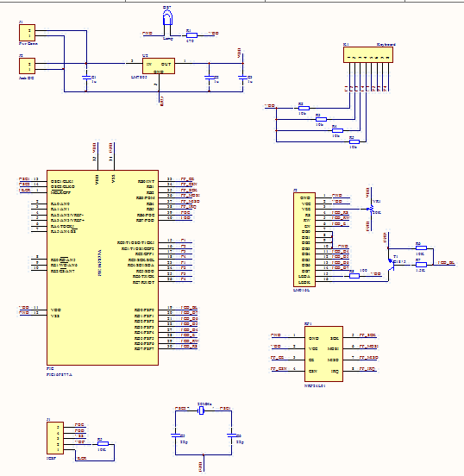
Hardware
Hard & Soft
SMO schematic

Slide 21
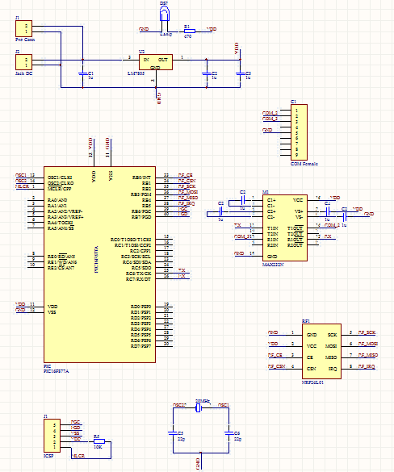
Hardware
Hard & Soft
SMR schematic

Slide 22
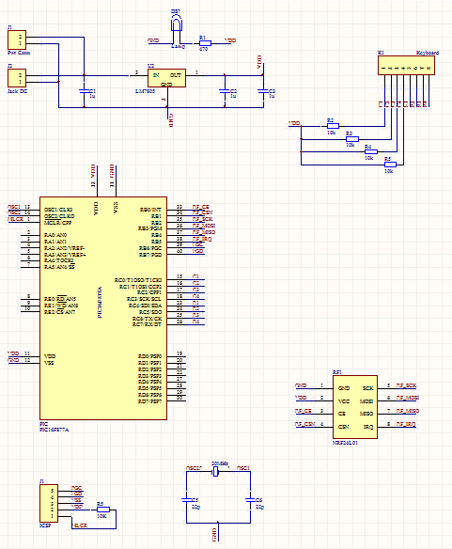
Hardware
Hard & Soft
SMC schematic

Slide 23
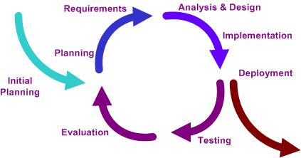
Software
Hard & Soft
Iterative development model
Notes:
Note: Cần giải thích kỹ hơn từng keyword khi thuyết trinh

Slide 24
Software
Hard & Soft
Planning phase, in which the plane for this project is created
Requirement phase, in which the requirements for the software are gathered and analyzed.
Design phase, in which software solution to meet the requirements is designed.
Implementation phase, when the software is code and integrated.
Test phase, when the software is tested.
Evaluation phase, in which the software is evaluated.
Deployment phase, in which the system is deployed.
Notes:
Note: Cần giải thích kỹ hơn từng keyword khi thuyết trinh

Slide 25
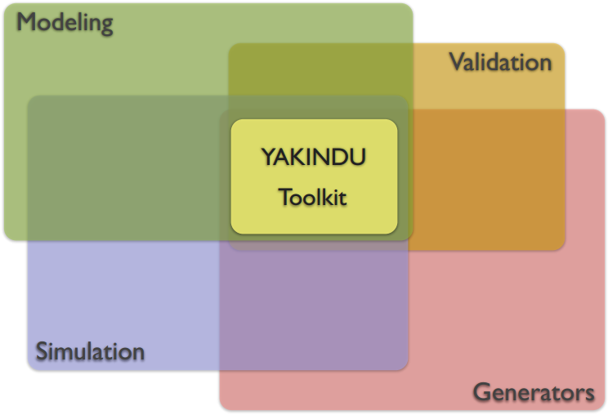
Software
Hard & Soft
What is Yakindu?
Yakindu is a modular toolkit for model driven development of embedded systems.
Yakindu is:
Build on Eclipse.
Open source.
Available at Eclipse Labs.
Links:
http://eclipselabs.org/p/yakindu
http://yakindu.org
Notes:
Note: Cần giải thích kỹ hơn từng keyword khi thuyết trinh

Slide 26
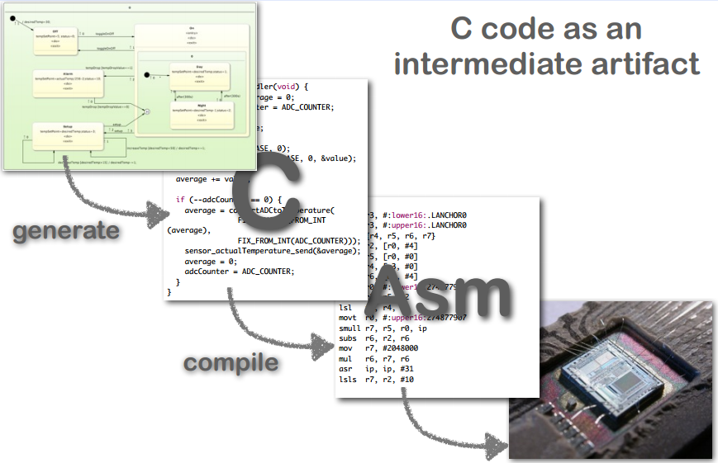
Software
Hard & Soft
Model Driven Development (MDD)
Abstraction Levels:

Slide 27
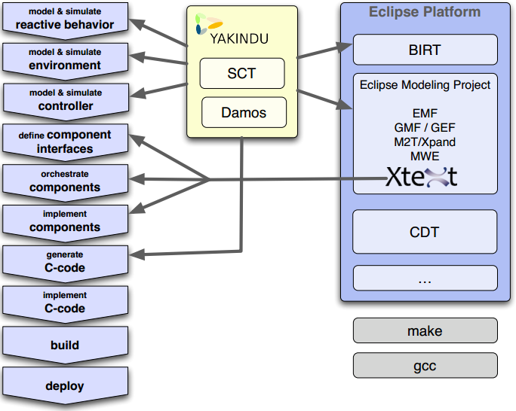
Software
Hard & Soft
Activities & Tools

Slide 28
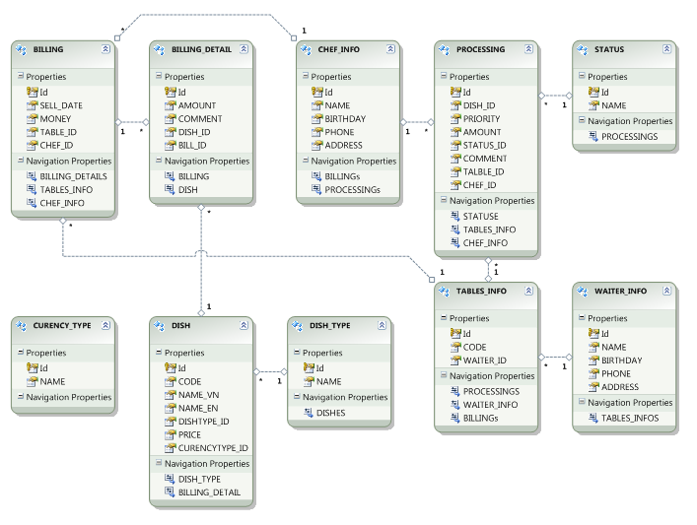
Software
Hard & Soft
Database

Slide 29
Risk
Hard & Soft
Half of project team members do not have experiences working in real project.
The team leader lack of project management skill, experiences.
None of the project team members has been work as tester position.
The facilitation for developing the project maybe the risk (like places, equipment , etc…)
Lack of experiences of estimating time and budget for developing project.

Slide 30
Principles
Mechanism

Slide 31
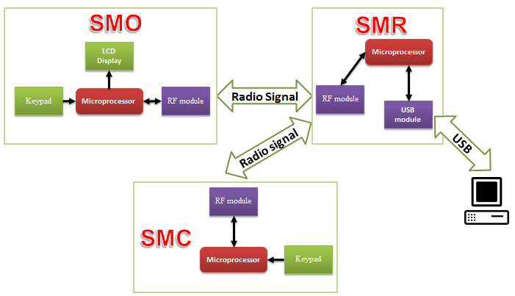
Design
Mechanism

Slide 32
Design
Mechanism

Slide 33
Experience

Slide 34
Potential
Conclusion
Awesome application of IT.
Criteria for top class expressing.
Bring absolute satisfaction for customers.
Contribute more sales for restaurant.

Slide 35

www.themegallery.com
Thank You !
From SMS team with love

